Slide 1
DISGRUNTLED SHAREHOLDERS: acting for and against them
Fraser Campbell KC
Gayatri Sarathy
10 February 2025

Slide 2
Different kinds of dispute
Co-founders
Family companies
Private equity
Activist shareholders

Slide 3
Different kinds of action
Unfair prejudice (s. 994 CA 2006)
Derivative claims
Claims against directors
JVA/SHA claims
Just and equitable winding up

Slide 4
Section 994 of the Companies Act 2006
(1) A member of a company may apply to the court by petition for an order under this Part on the ground –
(a) that the company’s affairs are being or have been conducted in a manner that is unfairly prejudicial to the interests of members generally or of some part of its members (including at least himself), or
(b) that an actual or proposed act or omission of the company (including an act or omission on its behalf) is or would be so prejudicial …

Slide 5
ClientEarth v Shell Plc [2023] EWHC 1897 (Ch)
84. … I do not consider that ClientEarth has made out a prima facie case that the Directors are in breach of their duties in the respects alleged. Shell also submitted that, standing back from the detail, it is far-fetched to think that an independent director, acting in accordance with their duties under s.172 of CA 2006, would consider it appropriate to launch the kind of litigation contemplated in the present case against the entire board of Shell. I think that this is a useful question for the court to ask itself. In my view the application and the evidence adduced in support of it admit of only one answer: such a director would not do anything other than decline to continue the claim.

Slide 6


Opens in a new window www.shutterstock.com

Slide 7
Bates v Post Office Ltd [2019] EWHC 606 (QB)
711. I consider that there is a specie of contracts, which are most usefully termed “relational contracts”, in which there is implied an obligation of good faith (which is also termed “fair dealing” in some of the cases). This means that the parties must refrain from conduct which in the relevant context would be regarded as commercially unacceptable by reasonable and honest people. An implied duty of good faith does not mean solely that the parties must be honest.

Slide 8
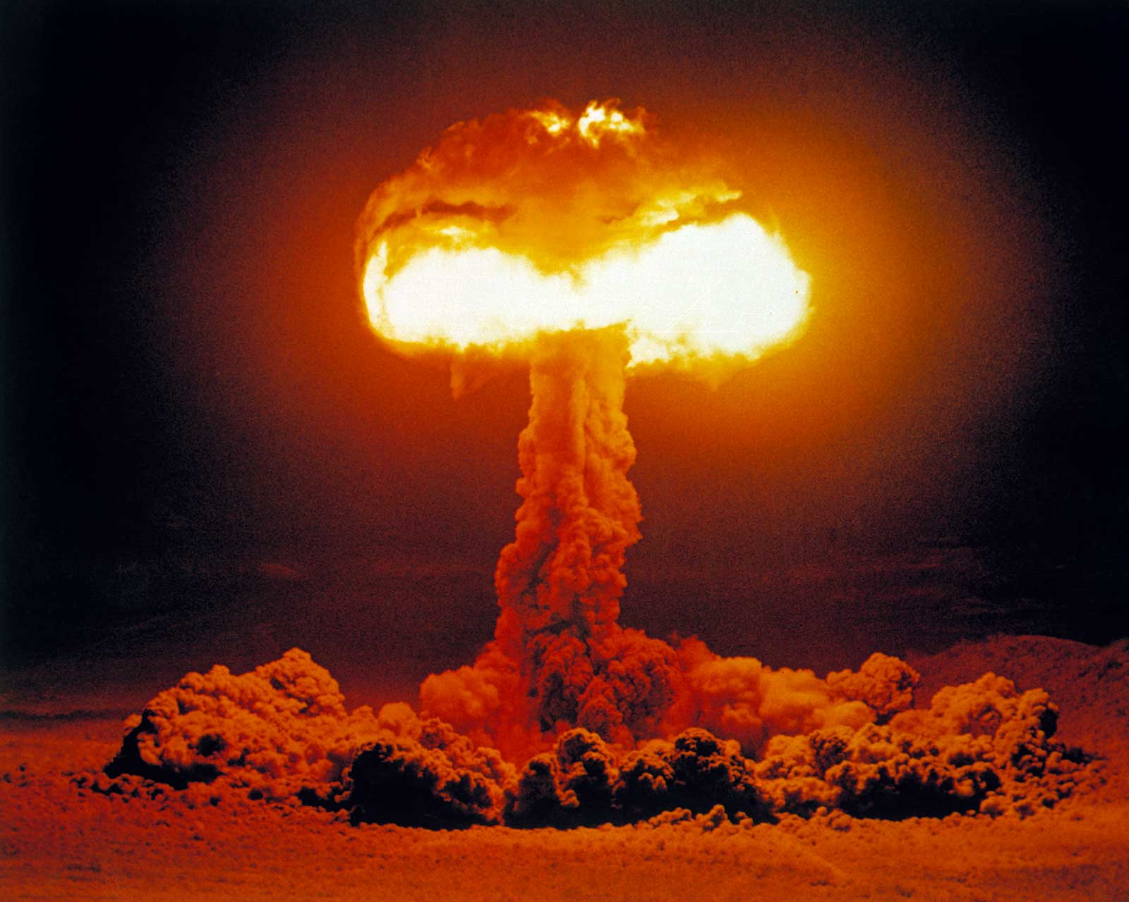

Slide 9
Unfair prejudice: remedial considerations
Broad discretion
Buy-out assumptions
Valuation issues

Slide 10
Section 996 of the Companies Act 2006
(1)If the court is satisfied that a petition under this Part is well founded, it may make such order as it thinks fit for giving relief in respect of the matters complained of.
(2)Without prejudice to the generality of subsection (1), the court's order may—
(a)regulate the conduct of the company's affairs in the future …
(e)provide for the purchase of the shares of any members of the company by other members or by the company itself and, in the case of a purchase by the company itself, the reduction of the company's capital accordingly.

Slide 11


Slide 12


Slide 13
Tactical considerations
Targets
Kitchen-sink claims
Putting it right
Interim remedies
Split trials / preliminary issues
Privilege in company documents

Slide 14


Slide 15
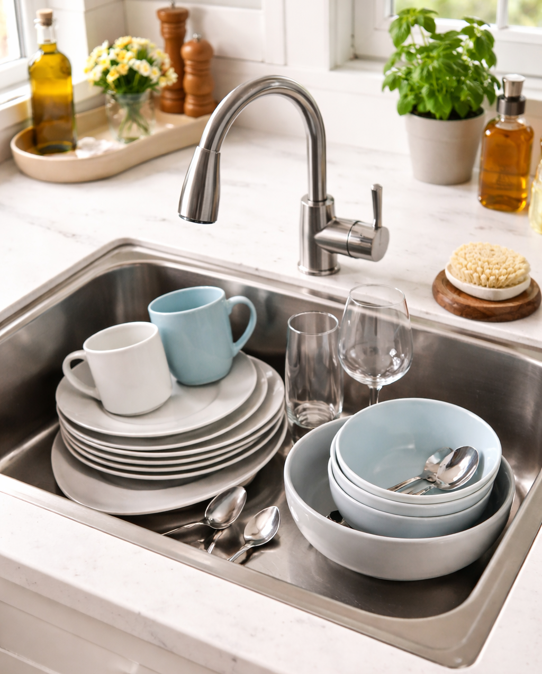

Slide 16


Slide 17
Interim remedies
Preventing the use of company funds: Koza Ltd v Koza Altin Isletmeleri AS [2021] EWHC 786 (Ch).
Removal and appointment of directors: Re Volorem Holdings Ltd [2023] EWHC 2625 (Ch).
Requiring board approval for significant transactions: Dilato Holdings Pty Ltd v Learning Possibilities Ltd [2015] EWHC 592 (Ch).
Preventing a company from issuing new shares and loan notes: Re Brickvest Ltd [2019] EWHC 2662 (Ch).

Slide 18
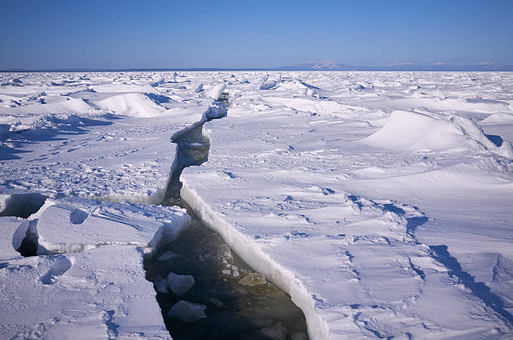

Slide 19
Jardine Strategic Ltd v Oasis Investments II Master Fund Ltd [2025] AC 1558
“80. The Board is satisfied that the Shareholder Rule forms no part of the law of Bermuda, and that it ought not to continue to be recognised in England and Wales either.
…
82. The status-based automatic Shareholder Rule is therefore now, and in truth has always been, a rule without justification. Like the emperor wearing no clothes in the folktale, it is time to recognise and declare that the Rule is altogether unclothed.”

Slide 20


