Slide 1
Transparency and Open Justice :
MRS JUSTICE COCKERILL DBE
Where we are, and what to expect ….

Slide 2
Introduction
to the Transparency and Open Justice Board’s rationale

Slide 3
The starting point
The accepted open justice position:
“Justice must be done and it must be seen to be done”

Slide 4
Are we living up to this?
The big question …

Slide 5
Who needs to see justice being done?
The Press
The Government
Public/Individuals
Future participants in the system

Slide 6

Concerns:
House of Commons Justice Committee
Open Justice: “Court reporting in the digital age” 2022-2023
Open justice is being transformed by the digital age
Journalists and members of the public often have to overcome significant barriers to identify, attend and follow court proceedings
Online procedures introduced …have had a negative impact on transparency.
The gradual increase in the courts’ reliance on documents has resulted in journalists being left behind”

Slide 7
Conclusion
“In the digital age, it is vital the Government, Parliament and the Judiciary work together to ensure that a balanced approach to open justice is achieved so that public scrutiny of justice can be secured without damaging the quality of the justice administered in the courts.”

Slide 8
Call for Evidence: responses (2025)
Public understanding of the courts system and how decisions are reached was seen as a key element of the rule of law, to keep the law accessible and maintain confidence in the system
Listings
Physical access
Remote observation
Broadcasting
Publication
Access to Court Documents
Data Access and Reuse
Public Legal Education

Slide 9
Documents
“respondents, including academics and media representatives noted that they are not clear how and when they should apply to access court documents”
“respondents consistently highlighted that availability of documents and information was too limited.”

Slide 10
▪Conclusion:
“In general, respondents agreed that, unless there is a good reason not to, non-parties should have sufficient access to documents (for example, witness statements, applications, and skeleton arguments) to ensure they can understand the hearings and judgments”

Slide 11
The Transparency and
Open Justice Board

Slide 12

30 April 2024
Justice must be done, and it must be seen to be done. The public has a right to know what happens in their Courts and Tribunals.
For all Courts and Tribunals, the overriding objective is to deal with cases justly. Confidence in that process is built on the principles of transparency and open justice.
The Lady Chief Justice has created the Transparency & Open Justice Board (“the Board”)

Slide 13
Key Objectives
The Key Objectives represent the high-level outcomes that, once finalised, will guide the Board’s work; will be used to identify areas where changes can and should be made; and, finally, will be used to measure the outcomes from any change programme.
Role: The Route Map

Slide 14
Key Objectives: riders
Open justice is the default position but there are recognised limitations to the principle. Some of the limitations are imposed by statute or statutory rules, which are set by Parliament not the Judiciary; any changes are a matter for Parliament, not the Judiciary. Sometimes, a Court or Tribunal will only be able to do justice in a particular case by departing from the principle of open justice. Any such departure from open justice must be necessary, proportionate, and justified.
In some areas, the ability of the Courts and Tribunals to deliver open justice is dependent upon the availability of resources and support from the Ministry of Justice and HMCTS.

Slide 15
Key Objectives: components
Open Courts
Open Reporting
Open Decisions
Open Documents

Slide 16
Open Courts
Our courts are open
But how many people know that?

Slide 17
Open Decisions
Aren’t they already?

Slide 18
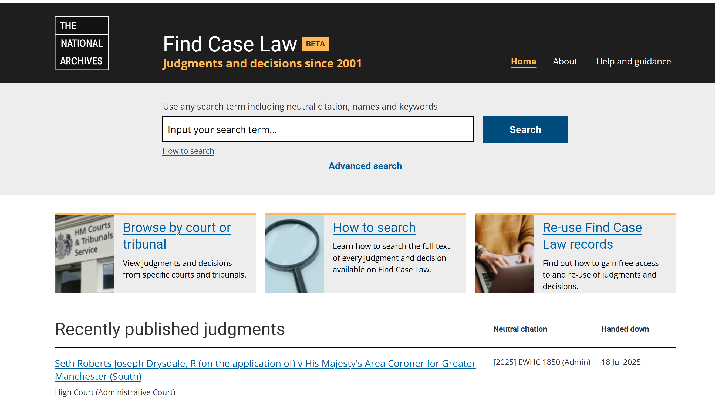
National Archives

Slide 19
Open Reporting:
The Press

Slide 20
LCJ: Speech to the Society of Editors
I am already on the record as a firm believer in the fundamentally important role that a free, robust, high-quality, and rigorously independent local, regional, and national press has in our civic society. It is that role that I would very much like to see strengthened
The judiciary and media share a common duty: we are and must continue to be the guardians of open justice. The greatest threat comes not from direct attack on the principle, but rather from careless – sometimes inadvertent – failures to protect its ideals. I intend the judiciary to step up,
[The Board that I have established will take this important work forward.. [it] will review and challenge the way that the judiciary works and ensure that openness and transparency is at the heart of what we do. We will renew the promise that justice will not only be done, but will be seen to be done.

Slide 21
Broadcasting of sentencing remarks
Since July 2022
Only in selected cases
Feedback largely positive
Huge number of hits on Letby, Rudukabana sentencing remarks
Interesting depth of understanding in comments posted online

Slide 22
But, says the UWE:
Overall, the researchers suggest that broadcasting hasn’t significantly expanded open justice. The portrayal of crime and sentencing remains focused on severe cases and lifelong imprisonment, ignoring common crimes like intimate partner violence, theft, assault, white-collar crimes, and drug offences.
Cases selected for broadcast were similar to those covered using traditional methods, arguably doing little to enhance public understanding and engage interest in criminal proceedings in a realistic and representative manner.

Slide 23
Court of Appeal Civil Division
Livestream since 2019
https://www.judiciary.uk/the-court-of-appeal-civil-division-live-streaming-of-court-hearings/
Since April 2025 pilot scheme in place for posting of
  appealed judgment
  skeleton arguments
Not in family or anonymised cases
Similar arrangements for Supreme Court

Slide 24
Coming soon….
Administrative Court Live streaming
"The Board has already recommended the extension of broadcasting to the Administrative Court and proposals are now a matter for the Ministry of Justice.”

Slide 25
Open Documents

Slide 26
A divergence in practice ….
Criminal C20
Civil C20
All witnesses examined in chief orally
All documents read out loud in court
All legal argument made orally
A member of the public has exactly the same material as the jury and can follow the trial
All witnesses examined in chief orally
All documents read out loud in court
All legal argument made orally
A member of the public hears exactly what the judge hears and can follow the trial

Slide 27
Now
Criminal
Civil
All witnesses examined in chief orally
All documents read out loud in court
All legal argument made orally
A member of the public has exactly the same material as the jury and can follow the trial
All witnesses evidence introduced by written statement not available to the public
Documents:
  Almost no documents read out loud in court
  Judge pre-reads many of them by reference to long skeleton arguments
  Often a list of extra documents is given to the judge to read in their own time
Much legal argument is made in writing and where orally at pace by reference to written submissions
A member of the public hears has no chance of following what goes on in court

Slide 28
▪ “In general, respondents agreed that, unless there is a good reason not to, non-parties should have sufficient access to documents (for example, witness statements, applications, and skeleton arguments) to ensure they can understand the hearings and judgments”

Slide 29
How do we access documents?
CPR
Common Law
CPR 5.4C allows
access as of right to a statement of case (but not appendices), and judgments and orders made in public
Reflected in public access CE File
Also access with a court order (following application) to other “court records” (not defined)
At common law
It was long understood that the court had a discretion to order production of a document once it had entered into the public domain by being read out in court
  But no process in CPR for applying
  Has to be Part 23 application (cost/time)
  Usually resulted in direct correspondence to judges, advice having to be given as to how to apply etc…

Slide 30
The common law: Guardian and Dring
Guardian News and Media v City of Westminster Magistrates Court [2012] EWCA Civ 420
The default position is access should be permitted:
“In a case where documents have been placed before a judge and referred to in the course of proceedings, in my judgment the default position should be that access should be permitted on the open justice principle; and where access is sought for a proper journalistic purpose, the case for allowing it will be particularly strong”

Slide 31
Dring [2019] UKSC 38
Endorses the approach in the Guardian case
Notes the continued possibility of reasons for denying access
Identifies as default available:
the parties’ written submissions and arguments,
but also to the documents which have been placed before the court and referred to during the hearing.
Calls on the CPRC to “give consideration to the questions of principle and practice raised by this case”.

Slide 32
CPRC Sub- Committee: 2023
Asked to propose a rule change to enable “Dring” documents to be accessed is some more sensible way
Proposed an amendment to CPR 5.4C
  Skeleton arguments available before the hearing
  Witness statements and expert reports would be available when the witness is called
  But these documents would be provided by the parties after an application (as now)
Responses from LSLA
Extremely negative
Concerns re confidentiality – aspects not deployed in open court
Timing – before a hearing not accepted
Process?
Impact of applications during trial and affecting lead times and costs
“we presently find it difficult to see how our concerns could be resolved. “

Slide 33
Public Domain Documents Pilot
Sub-Committee initiated by the MR and DHCJ – in the light of TOJ crossover

Slide 34
The essence
We have CE File – use it!
We know what Dring documents are
We can add them to CE File once they become public domain documents

Slide 35
Dring Documents= Public Domain Documents
skeleton arguments;
written opening submissions;
written closing submissions;
other written submissions provided to a judge and relied upon in the hearing;
witness statements and affidavits –
including those relied upon as evidence in chief at trial and those relied upon at a public hearing of an application;
not including documents appended or annexed to the witness statement or affidavit;
expert reports, including –
those adduced as evidence in chief at trial and those relied upon at a public hearing of an application;
annexes and appendices to expert reports;
any other document or documents critical to the understanding of the hearing ordered by the judge at the hearing to be a Public Domain Document;
any documents agreed by the parties to be Public Domain Documents.

Slide 36
The Filing Obligation
Unless the court orders otherwise …., for the purposes of this Pilot [Dring Documents] which have been used or referred to at a hearing in public are Public Domain Documents from the start of the Filing Period.
Irrespective of whether the document has already been filed on CE-File website, […. the party which has produced any document which becomes a Public Domain Document ….must, …..file that document on CE-File website under the relevant CE-File designations listed in Table A within the Filing Period.

Slide 37
“Twists and olives”
Only open court hearings
No application to LIPs
No application to documents covered by pre-existing confidentiality or anonymisation orders
Can seek a “Filing Modification Order” modifying or disapplying the Filing Obligation
Non-party can seek a retrospective FMO

Slide 38




Aims
Provide Dring Documents
Simply
Cheaply
Quickly
Risk free
Via public facing CE File
Without creating work for court staff
No need for application or legal representation
No delay in waiting for an application to be listed
Documents uploaded by parties
Possibility of redaction or disapplication first

Slide 39
Pilot=Proof of concept
The idea is to check it works by giving it a run in one court – Commercial Court
Sophisticated and engaged user profile – who are fully supportive
Planned: six months there
Evaluation at the end
Plus assessment of views from next BPCs jurisdictions
Full rollout would be longer term and dependent on success
Due to commence October 2025
Approved by CPRC
Still needs ministerial sign-off

Slide 40
What to expect?

Slide 41

Coming soon …
…. To a court near you!

